Slide 1
Based on: Data mining techniques for marketing, sales, and CRM
Ch 1
Rohit Aggarwal

Slide 2
Data mining: a Business Process
A process that creates business value
A process that improves business operations
Call center calls being color-tagged as green, yellow and red
Cross-selling & up-selling
Retention of customers, especially SaaS
Acquire new customers
IDS
Wall street

Slide 3
3 pillars of data scientist
Depending on the role the following 3 would be required in varying degree:
Business/domain understanding (Why?)
Statistics understanding (What?)
Coding (How?)
Notes:
Start with Why? http://www.ted.com/talks/simon_sinek_how_great_leaders_inspire_action.html

Slide 4
Why now?
Cheap storage & processing
Data warehousing
Open source (*nix, Apache, Mysql, R)
Lower cost
Lesser lock ins
Larger pool of disaggregated consultancy firms
Digital penetration
Notes:
3 Vs (volume, velocity, and variety)

Slide 5
Data [driven business value] is the new Gold
McKinsey report: US businesses short of 200,000 data scientists per year
“Data is Daata”
Data scientist at Samsung. [Daata in hindi means God. ]
“Numbers do not lie. Politics and poetry promises these lies. Numbers are as close as we get to the hand writing of God.”
Dr. Gottlieb

Slide 6
Steps to create business value
Identifying [high priority] business opportunities & problems.
Mining data to transform the data into actionable information.
Acting on the information.
Measuring the results.

Slide 7
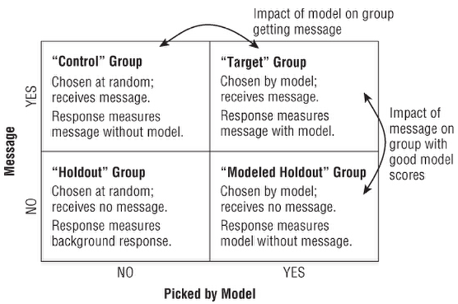
Data mining & performance tests
Notes:
If the Target Group has a higher response rate than the Control Group, it indicates that the modeling is working. If the Control Group has a higher response rate than the Holdout Group, it indicates that the marketing treatment is working.

Slide 8
Business side of a data miner
Prioritizing business problems that need to be acted upon
Figuring out what data needs to be collected
Figuring out for how long certain data needs to be collected
Deciding what reports would empower managers to make better business decisions
Making it easier for managers to understand reports and take actions
Measuring the results of actions

Slide 9
Conceptualizing business problem comprehensively
Eg Customer acquisition campaign
A basic measure is response rate
Good followup questions:
Did this campaign reach and bring in profitable customers?
Did a higher model score indicate a higher response rate?
Were these customers retained as well as would be expected?
What are the characteristics of the most loyal customers reached by this campaign?
Did the newly acquired customers purchase additional products?
Did some messages or offers work better than others?
Did customers reached by the campaign respond through alternate channels?

Slide 10
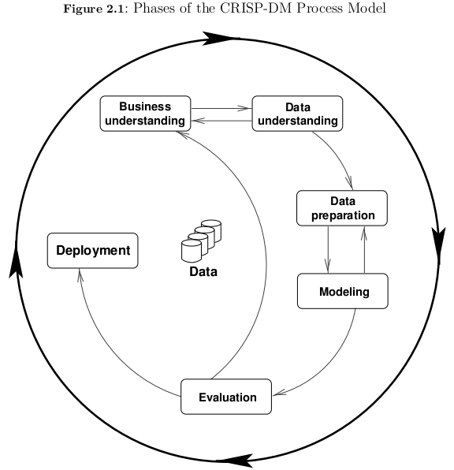
CRISP-DM
Source: Customer and business analytics book

